Slide 1
How to build an Industry Cost Profile (ICP) for a product in France
Identify industry code based on the supplier’s business and product
Step 2
Obtain financial and manufacturing information for the industry
Step 3
Step 1
Use industry data to calculate ratios for DM, DL, MOH, COGS, GSA & PBT

Slide 2
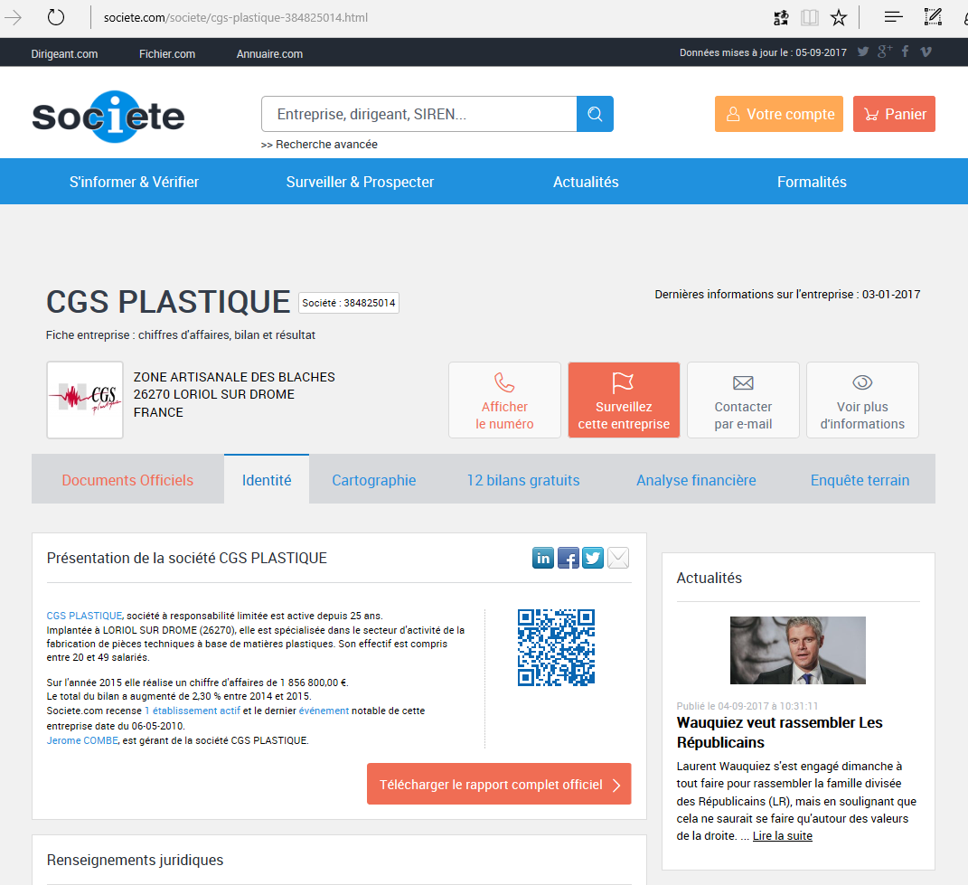
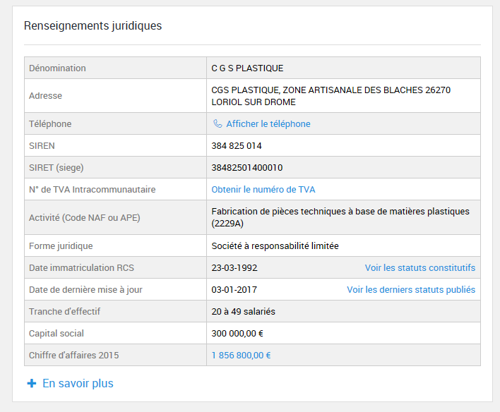
Identify industry code based on the supplier’s business and product
Step 1
Use for example:
Enter a company name and look for its “Activité (Code NAF ou APE)”
In this example we will build an ICP for “Plastic parts manufacturing” (French code NAF: 2229A Fabrication de pièces techniques à base de matières plastiques)
http://www.societe.com

Slide 3
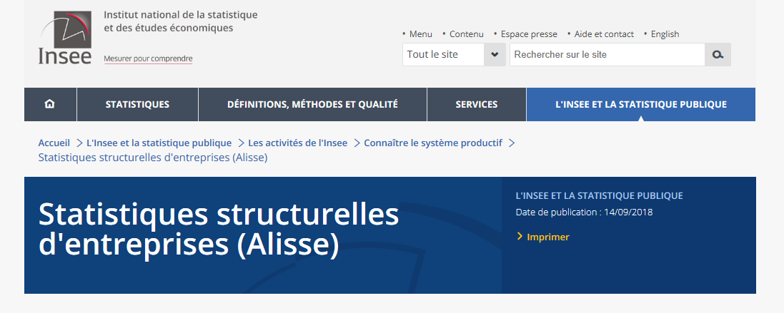
Obtain financial and manufacturing information for the industry
Step 2
Go to
Scroll down
Click on “Agrégats sectoriels : compte de résultat )”
https://www.insee.fr/fr/information/3291202

Slide 4
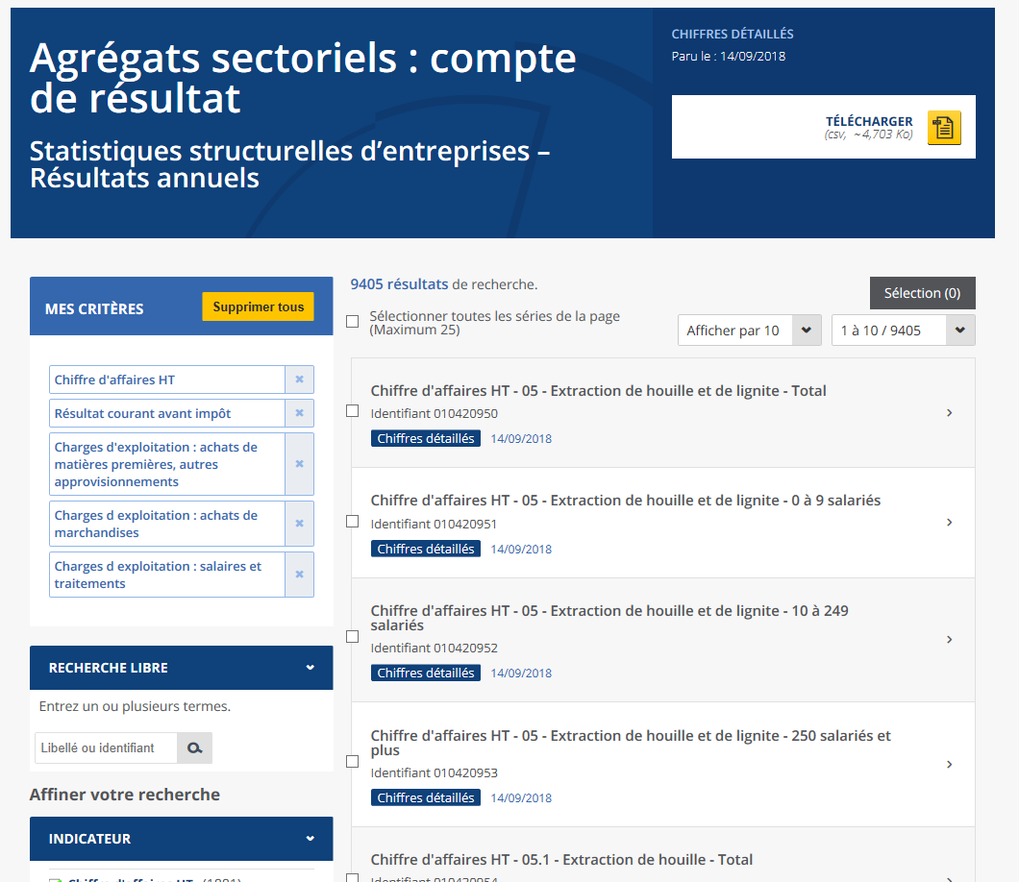
Obtain financial and manufacturing information for the industry
Step 2
Within section “INDICATEUR” on the left, select the following items:
Chiffre d’affaires HT
Résultat courant avant impôt
As well as 3 items labelled “Charges d’exploitation”:
achats de matières premieres, autres approvisionnements
achats de marchandises
salaires et traitements

Slide 5
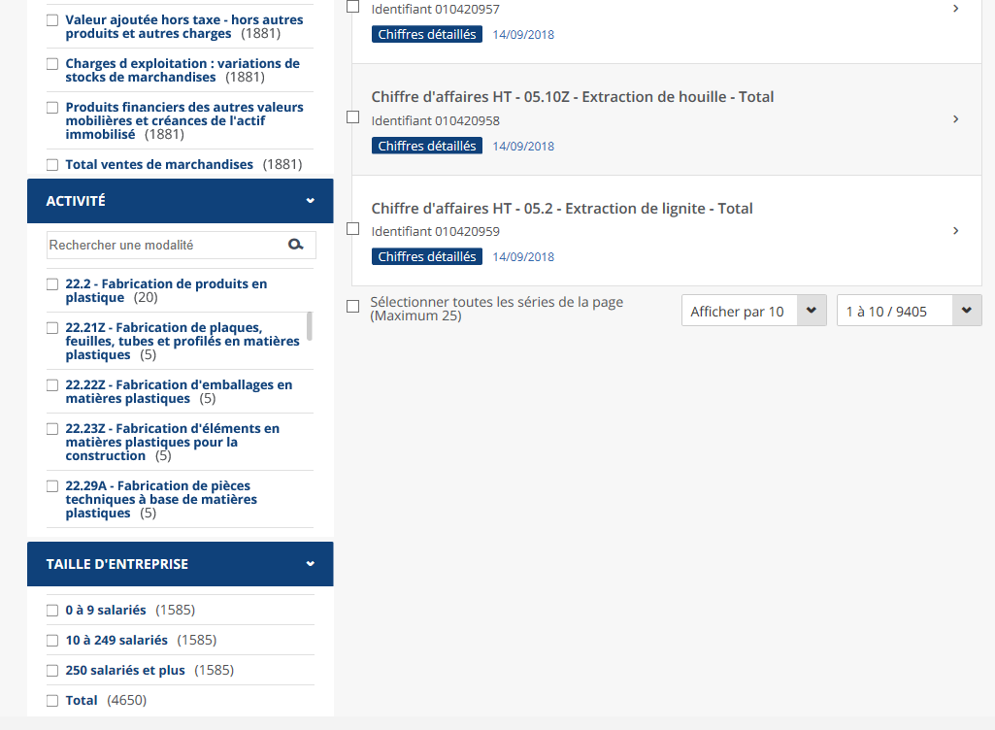
Obtain financial and manufacturing information for the industry
Step 2
Within section “ACTIVITE” on the left, select the industry of interest.
In this example we want to retrieve statistics for “Plastic parts manufacturing” (22.29A Fabrication de pièces techniques à base de matières plastiques)

Slide 6
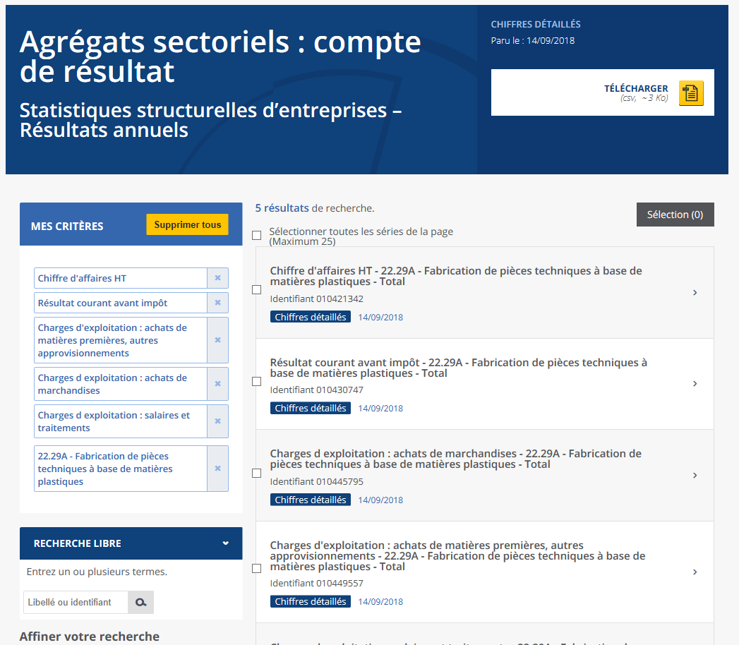
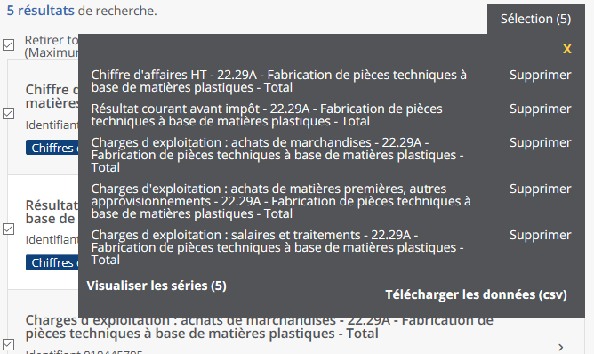
Obtain financial and manufacturing information for the industry
Step 2
Back at the top, check the box “Sélectionner toutes les séries de la page”
Click on button ‘Selection’ to the right
Click on ‘Visualiser les series’

Slide 7
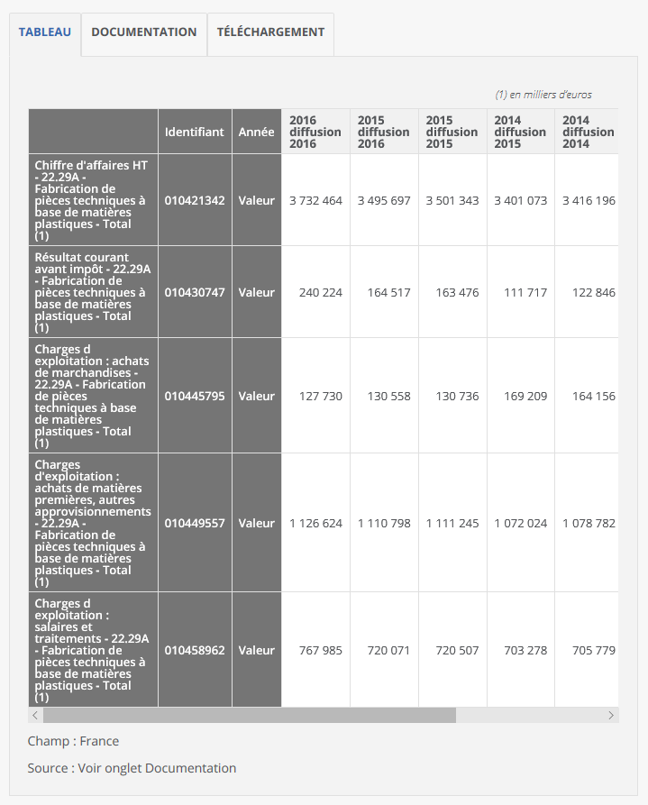
Obtain financial and manufacturing information for the industry
Step 2
Data on the 5 items for the selected industry is provided in a table.
Values presented are annual totals in 1,000’s of Euros.

Slide 8
Use Financial and Manufacturing Information to Calculate Ratios
Step 3
1. Calculate the Direct Material (DM) cost ratio as percentage of sales
In this example, we used data from the year 2016 (diffusion 2016)
2. Calculate the Total Labor (TL) cost ratio as percentage of sales
 | Achats de marchandises + Achats de matières premières, autres approv. (DM) | 1,126,624
 | Chiffre d'affaires HT (Sales) | 3,732,464
 | Direct Material (DM) | 30.2%
 | Salaires et traitements (TL) | 767,985
 | Chiffre d'affaires HT (Sales) | 3,732,464
 | Total Labor (TL) | 20.6%
1.
2.

Slide 9
Use Financial and Manufacturing Information to Calculate Ratios
Step 3
3. Use the procedure “Direct-to-Total Labor ratio –USA” for this industry. We will use this ratio as a proxy for this same industry in France.
In this example let’s assume we find:
DL/TL=62.6%
 | Total Labor (TL) | 20.6%
 | Direct Labor (DL) | =20.6%*0.626
 | Direct Labor (DL) | =12.9%
3.
Notes:
Korea-
Basic Metal Manufacturing
COGS 116,108,609
DM 79,607,506
DM/COGS=68%

Slide 10
Use Financial and Manufacturing Information to Calculate Ratios
Step 3
4. Calculate the Profit Before Tax (PBT) ratio as percentage of sales
5. Calculate the ratio for “Manufacturing Overhead + SGA & Other Expenses” as the difference between the Sales ratio (100%) and the sum of the other three ratios (DM+DL+PBT)
 | Résultat courant avant impôt (PBT) | 240,224
 | Chiffre d'affaires HT (Sales) | 3,416,196
 | Profit Before Tax (PBT) | 7.0%
4.
 | Sales | 100%
 | Less [ DM + DL + PBT ] | - 50.1%
 | Manufacturing Overhead + SGA & Other Expenses | 49.9%
5.

Slide 11
Present all your calculated ratios in the cost breakdown format
Industry cost profile for “Plastic parts manufacturing” in France
 | Direct Material (DM) | 30.2%
 | Direct Labor (DL) | 12.9%
 | Manufacturing Overhead (MOH) + SGA & Other Expenses | 49.9%
 | Profit Before Tax (PBT) | 7.0%
 | Total Sales | 100.0%
Ratios calculated from ”Institut national de la statistique et des études économiques (Insee)”

